Slide 1
Program for today
Lectures:
File manipulation, Python.
The Boliga dataset, and other data.
Exercise in wranglingand manipulate data in pandas.
Assigment 2 will be presented.
In-class exercises:
Forming groups: re-shuffle post-signup of electives.
Two exam questions to be formulated.
Forming GitHub groups: are we done?
Setting up a working Python environment, under guidance. Jupyter Notebooks, Vagrant, VirtualBox: are we done?

Slide 2
Business Intel
Predictive Analysis
Business Questions
Data Acquisition
Data Wrangling
Develop BI Model
Choose Reporting Platform
Choose Visualization Class
Deliver BI Reporting Results
Business Case
Data Acquisition
Feature Engineering
Develop ML Model
Train Model
Validate Model
Deploy Model
More like module 1
More like module 2

Slide 3
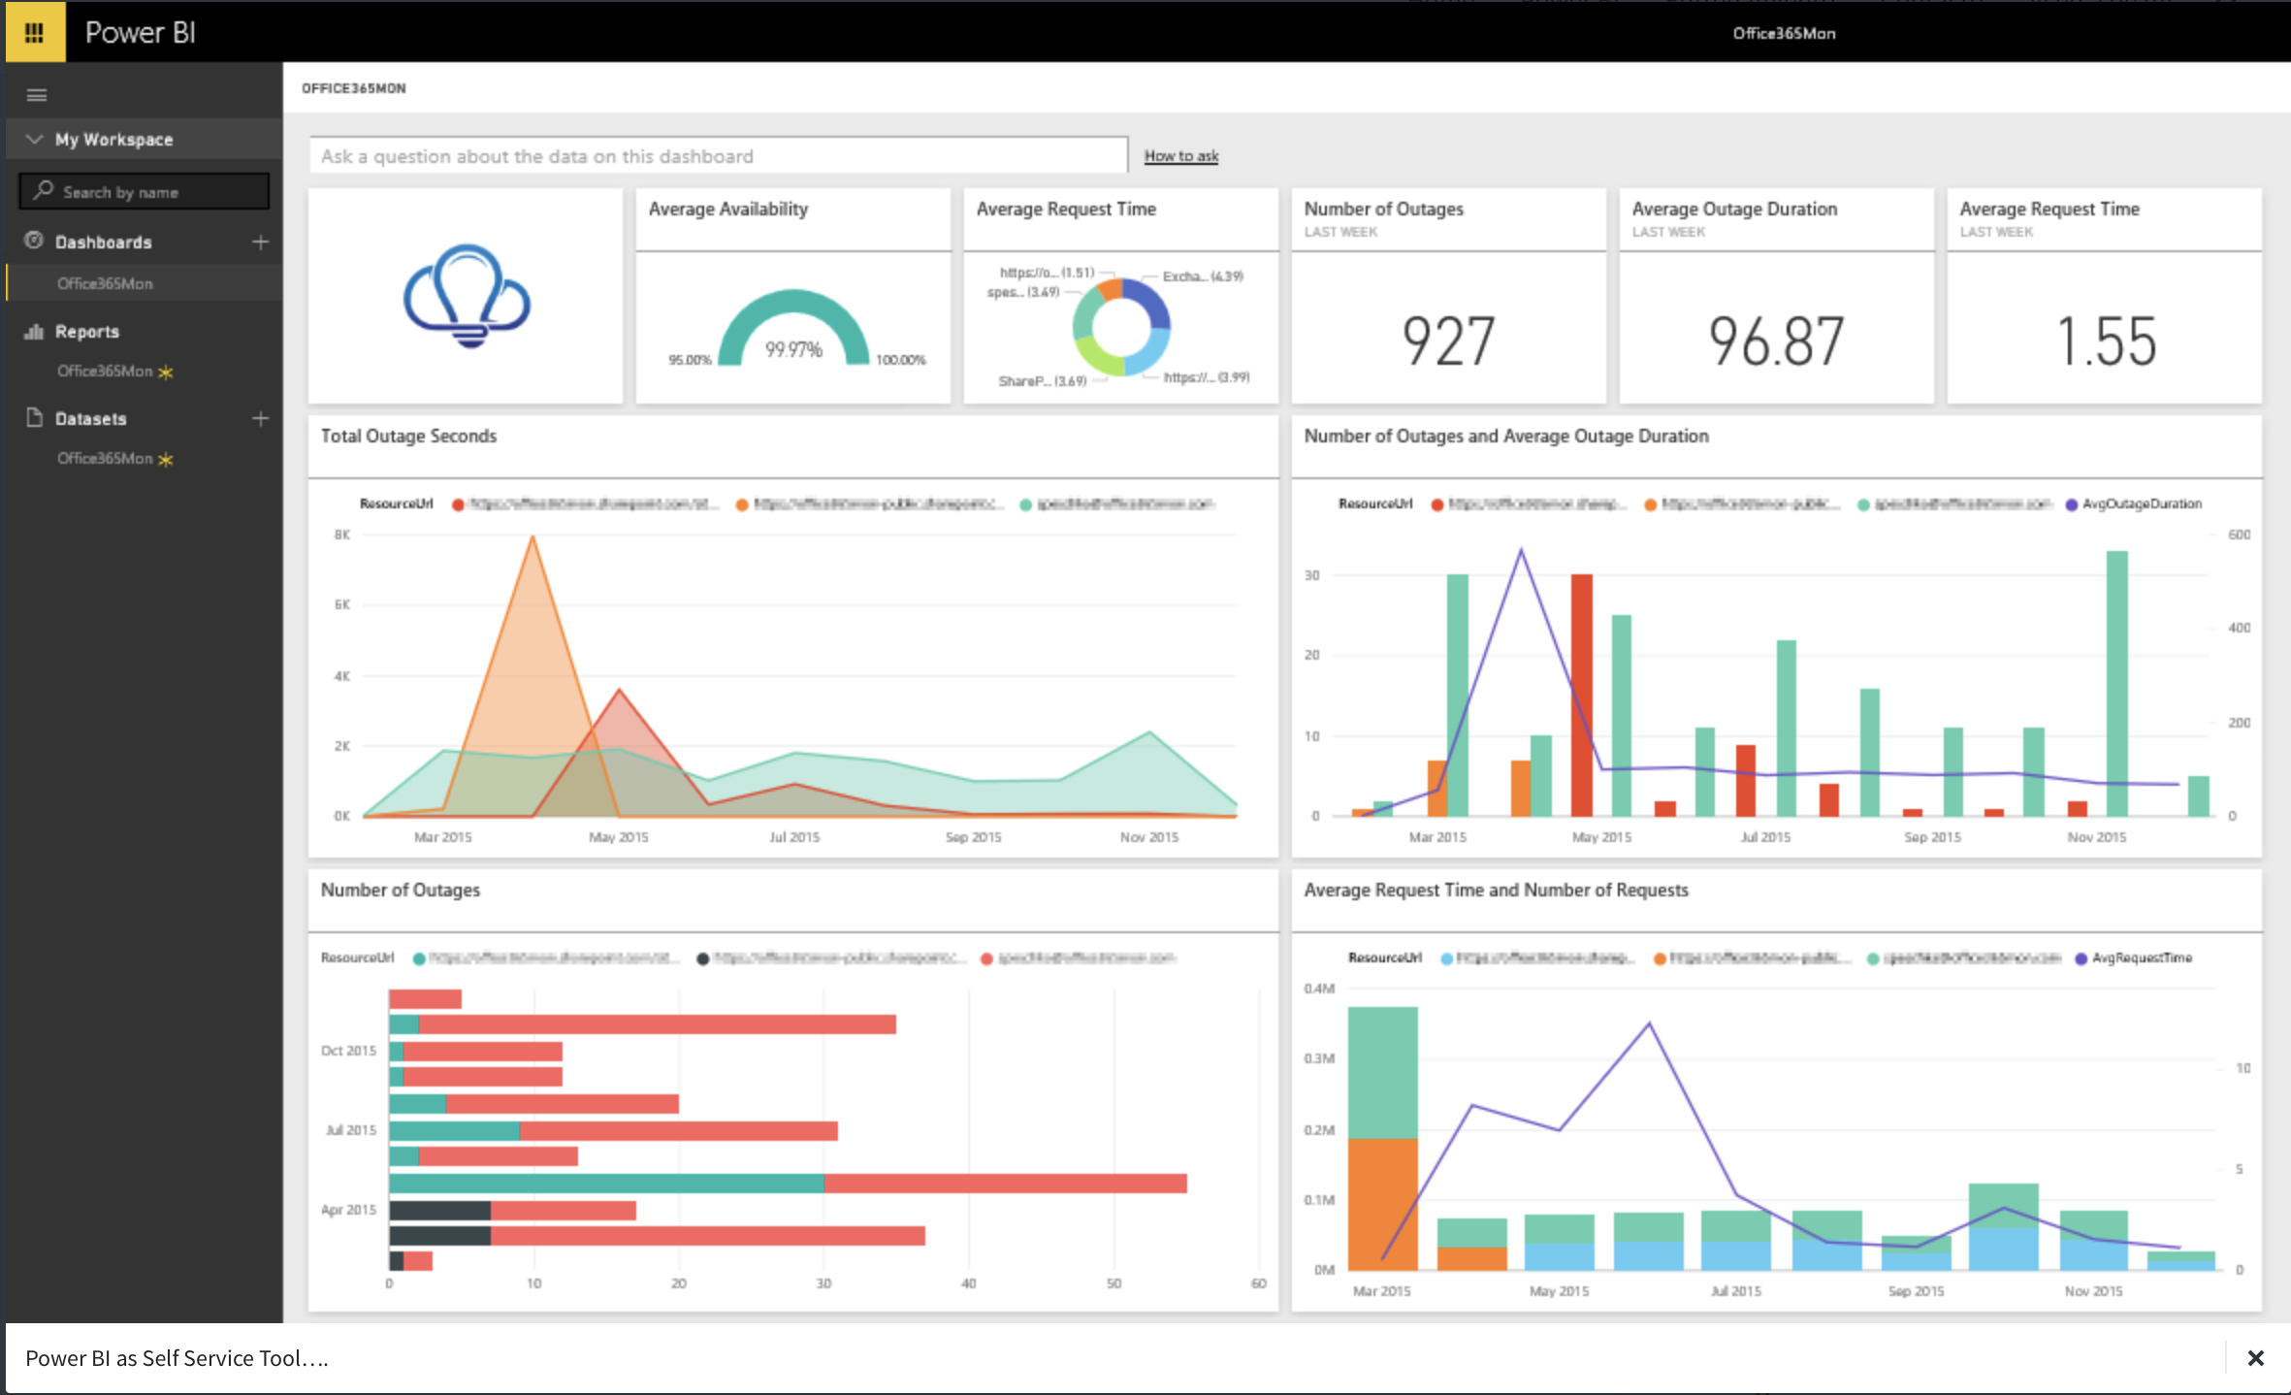
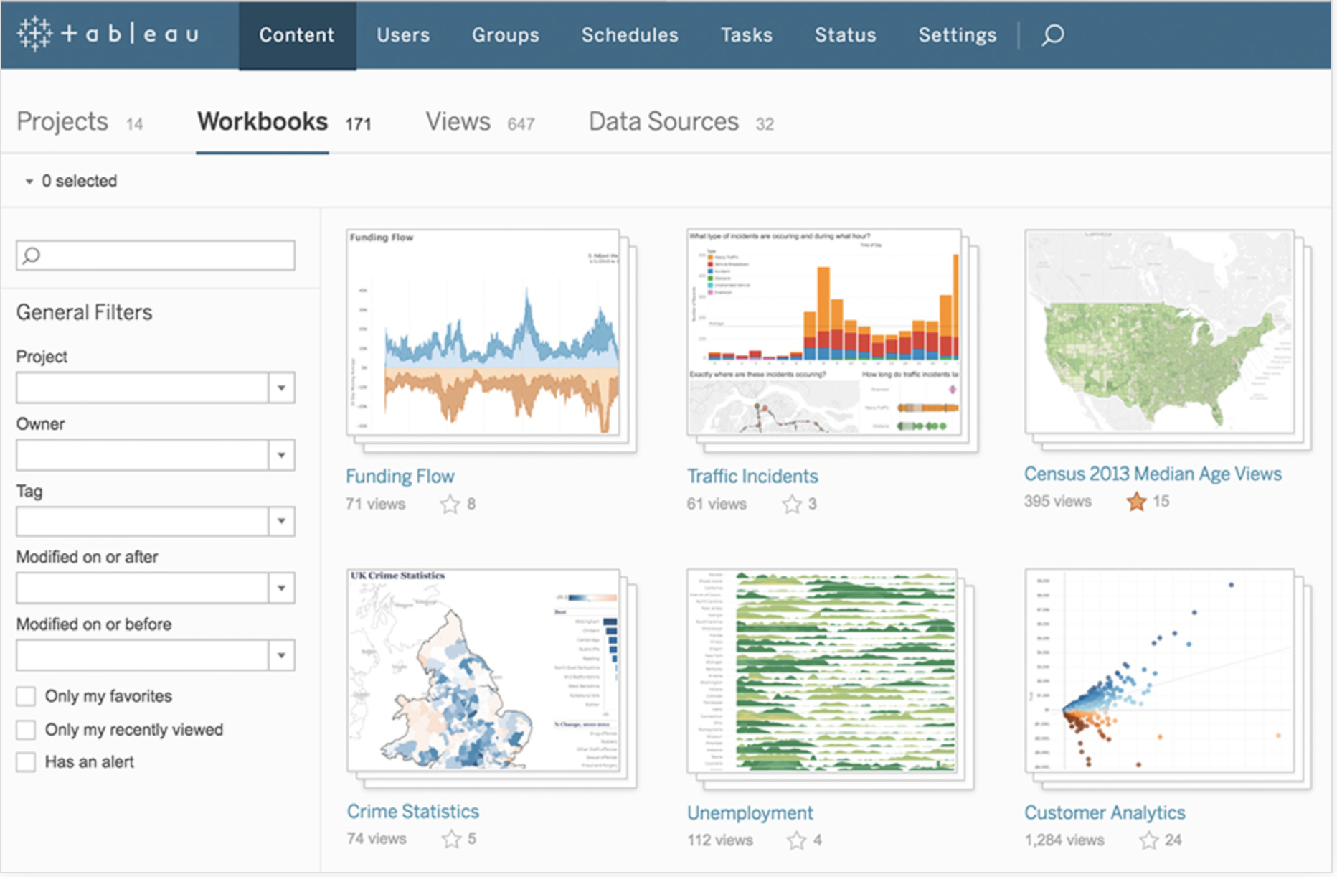
Tooling – reporting and graphing
The Usual Suspects
The Usual Suspects
Power BI (Microsoft)
Tableau (Tableau)

Slide 4
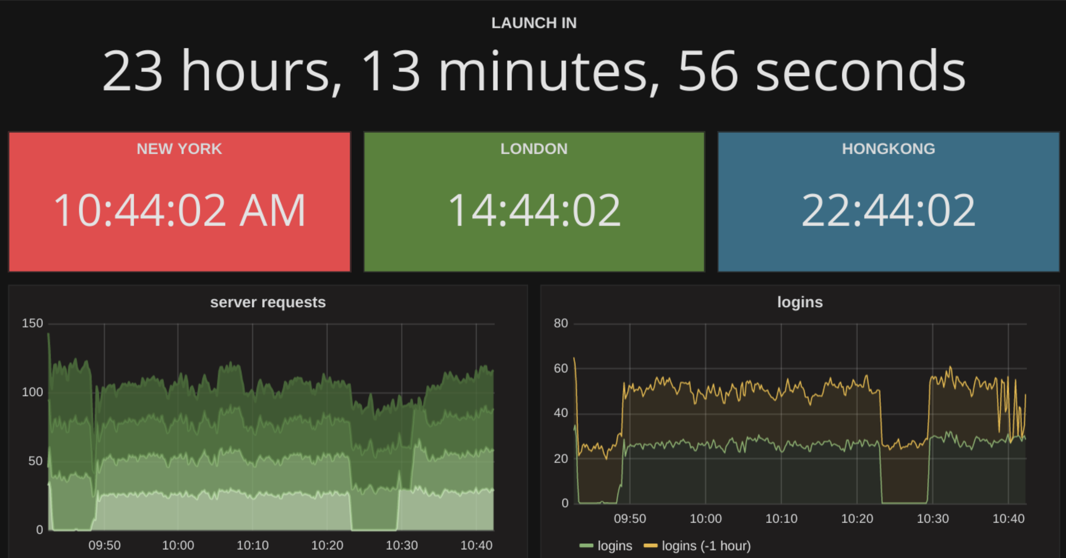
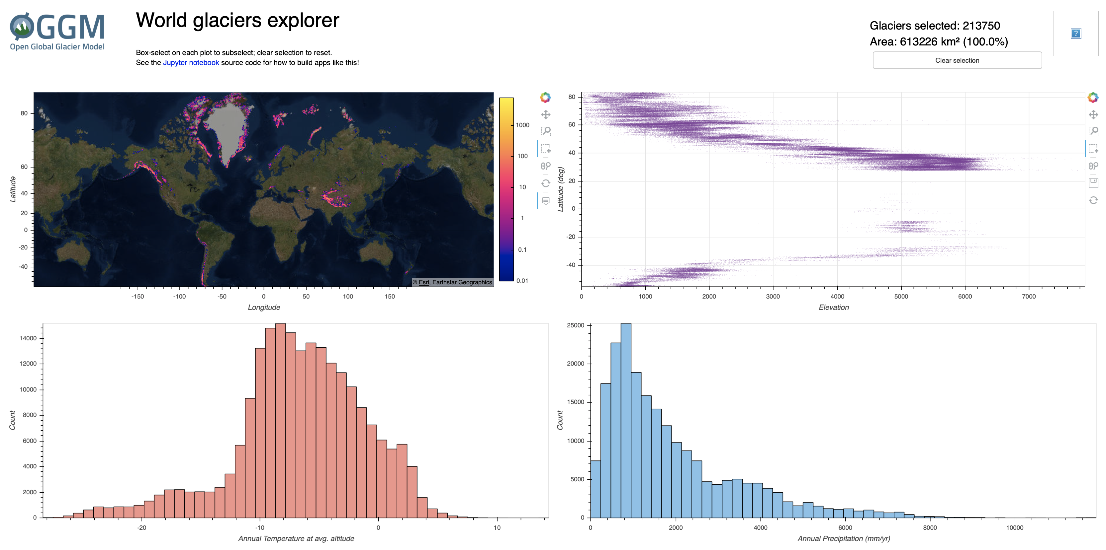
Tooling – reporting and graphing
Newcomers – ”Indies”
Runnner-ups – ”Indies”
Grafana (Grafana)
Panel (PyViz)

Slide 5
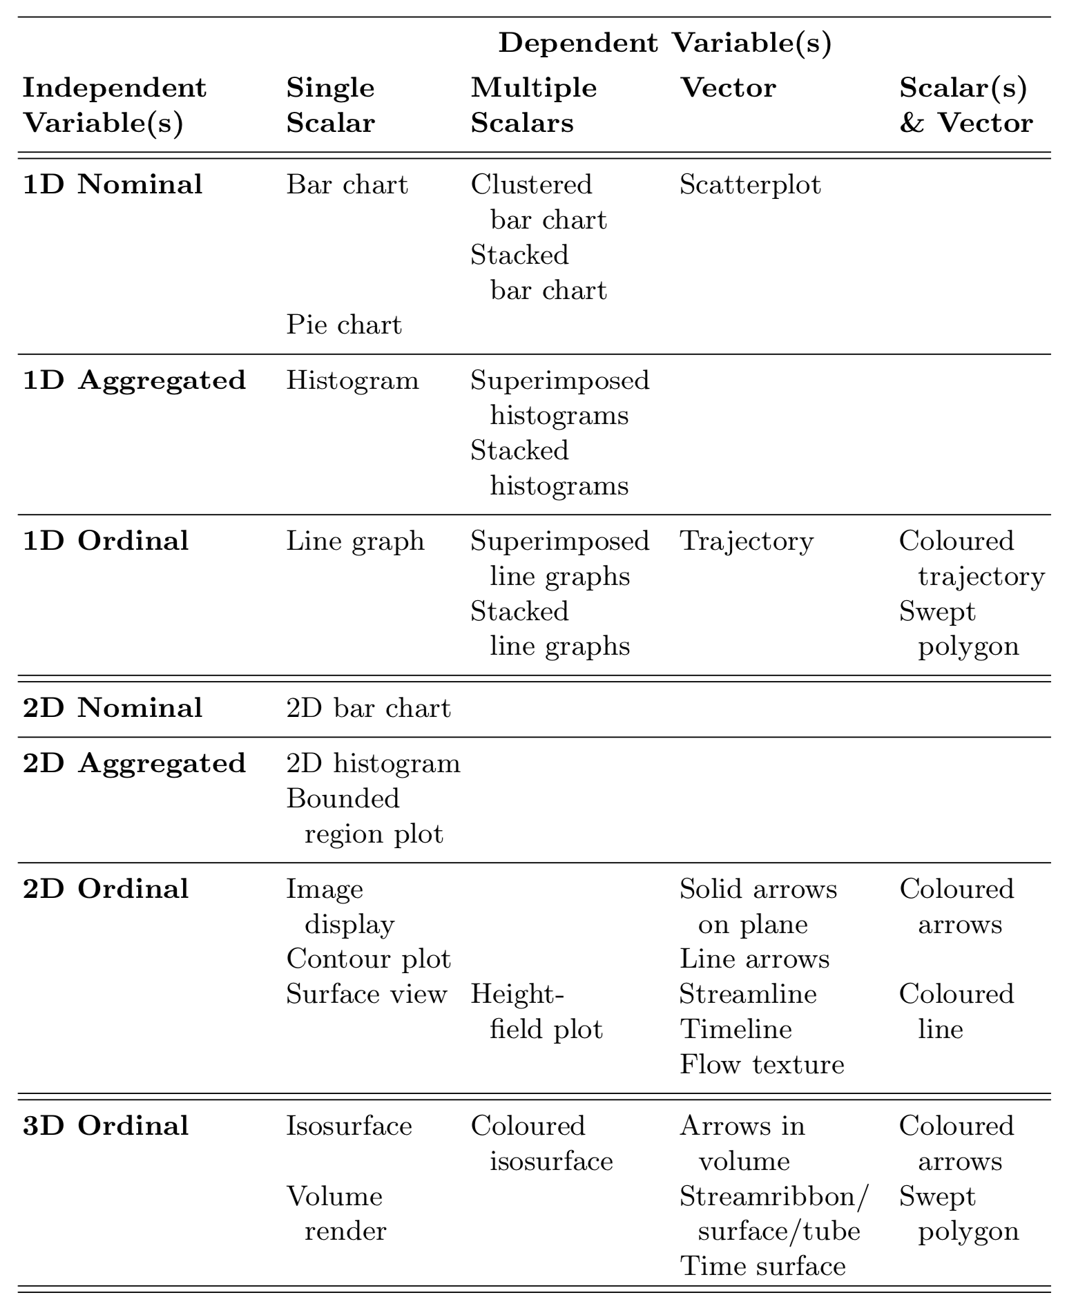
Visualization Taxonomy
A wealth of visualization classes
Business Intelligence is ALSO choosing the right class
Look at the data, then decide on presentation
Taxonomy is how we measure information richness in visualizations.
Exercise
In your groups....
Find at least one visualization on the internet for each of the three dimensionalities (red box) of Independent variables.

Slide 6
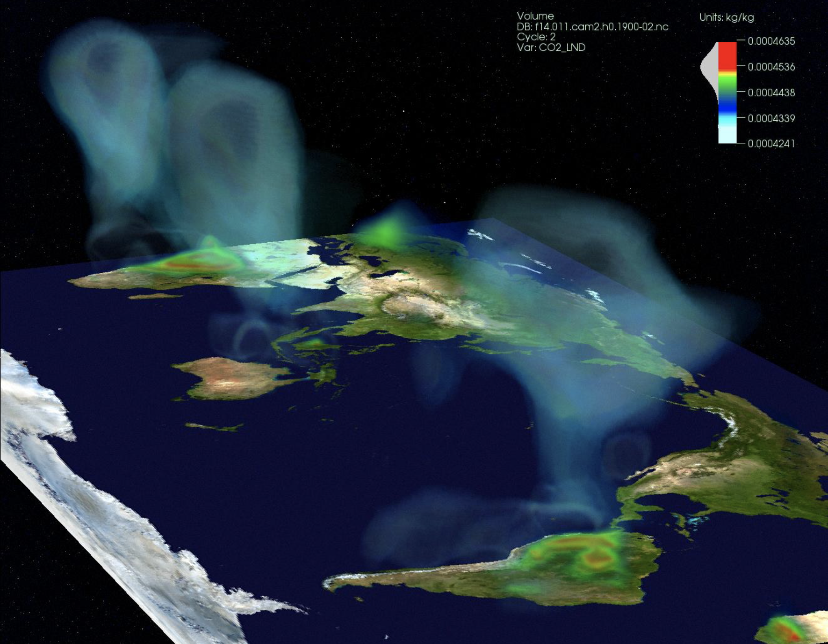
Exercise
In your groups....
Where would you place this visualization in the taxonomy?
Can you even do it?
How many dimensions are there (== features in data)

Slide 7
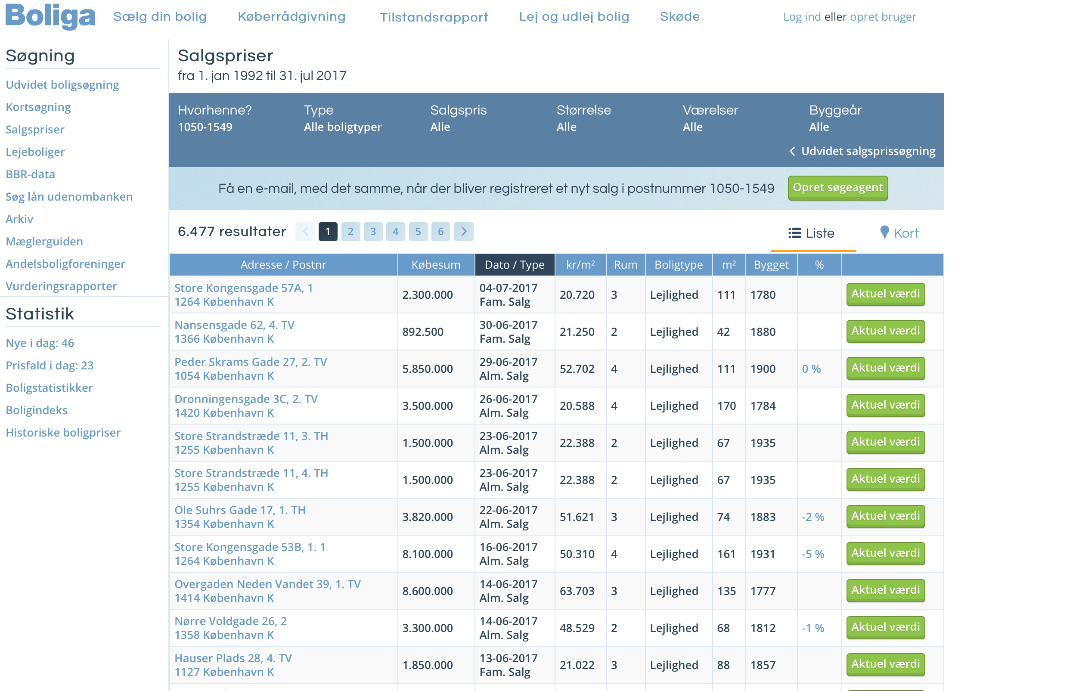
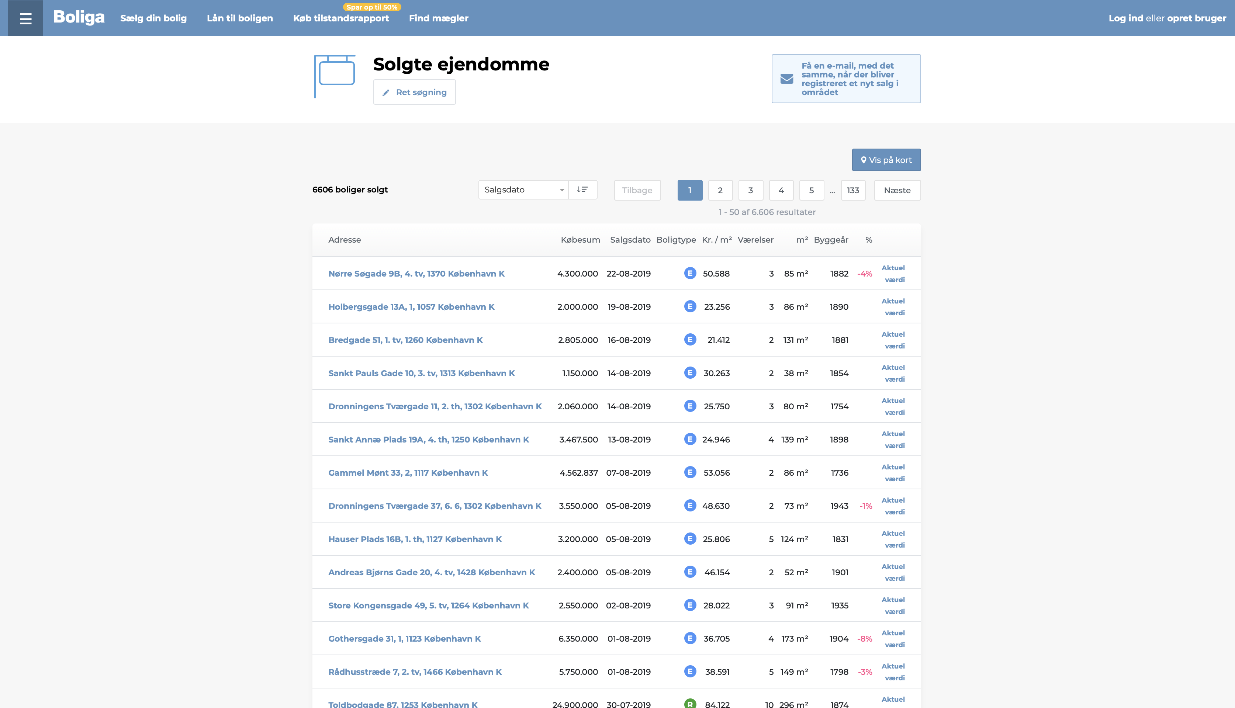
Boliga changed their website so we cannot scrape...
-- Extra Credits 1 --
Fix-It: HTML parsing from Python, in effect.
☺
*Get files and instruction from Jacob after class – if interested.

Slide 8
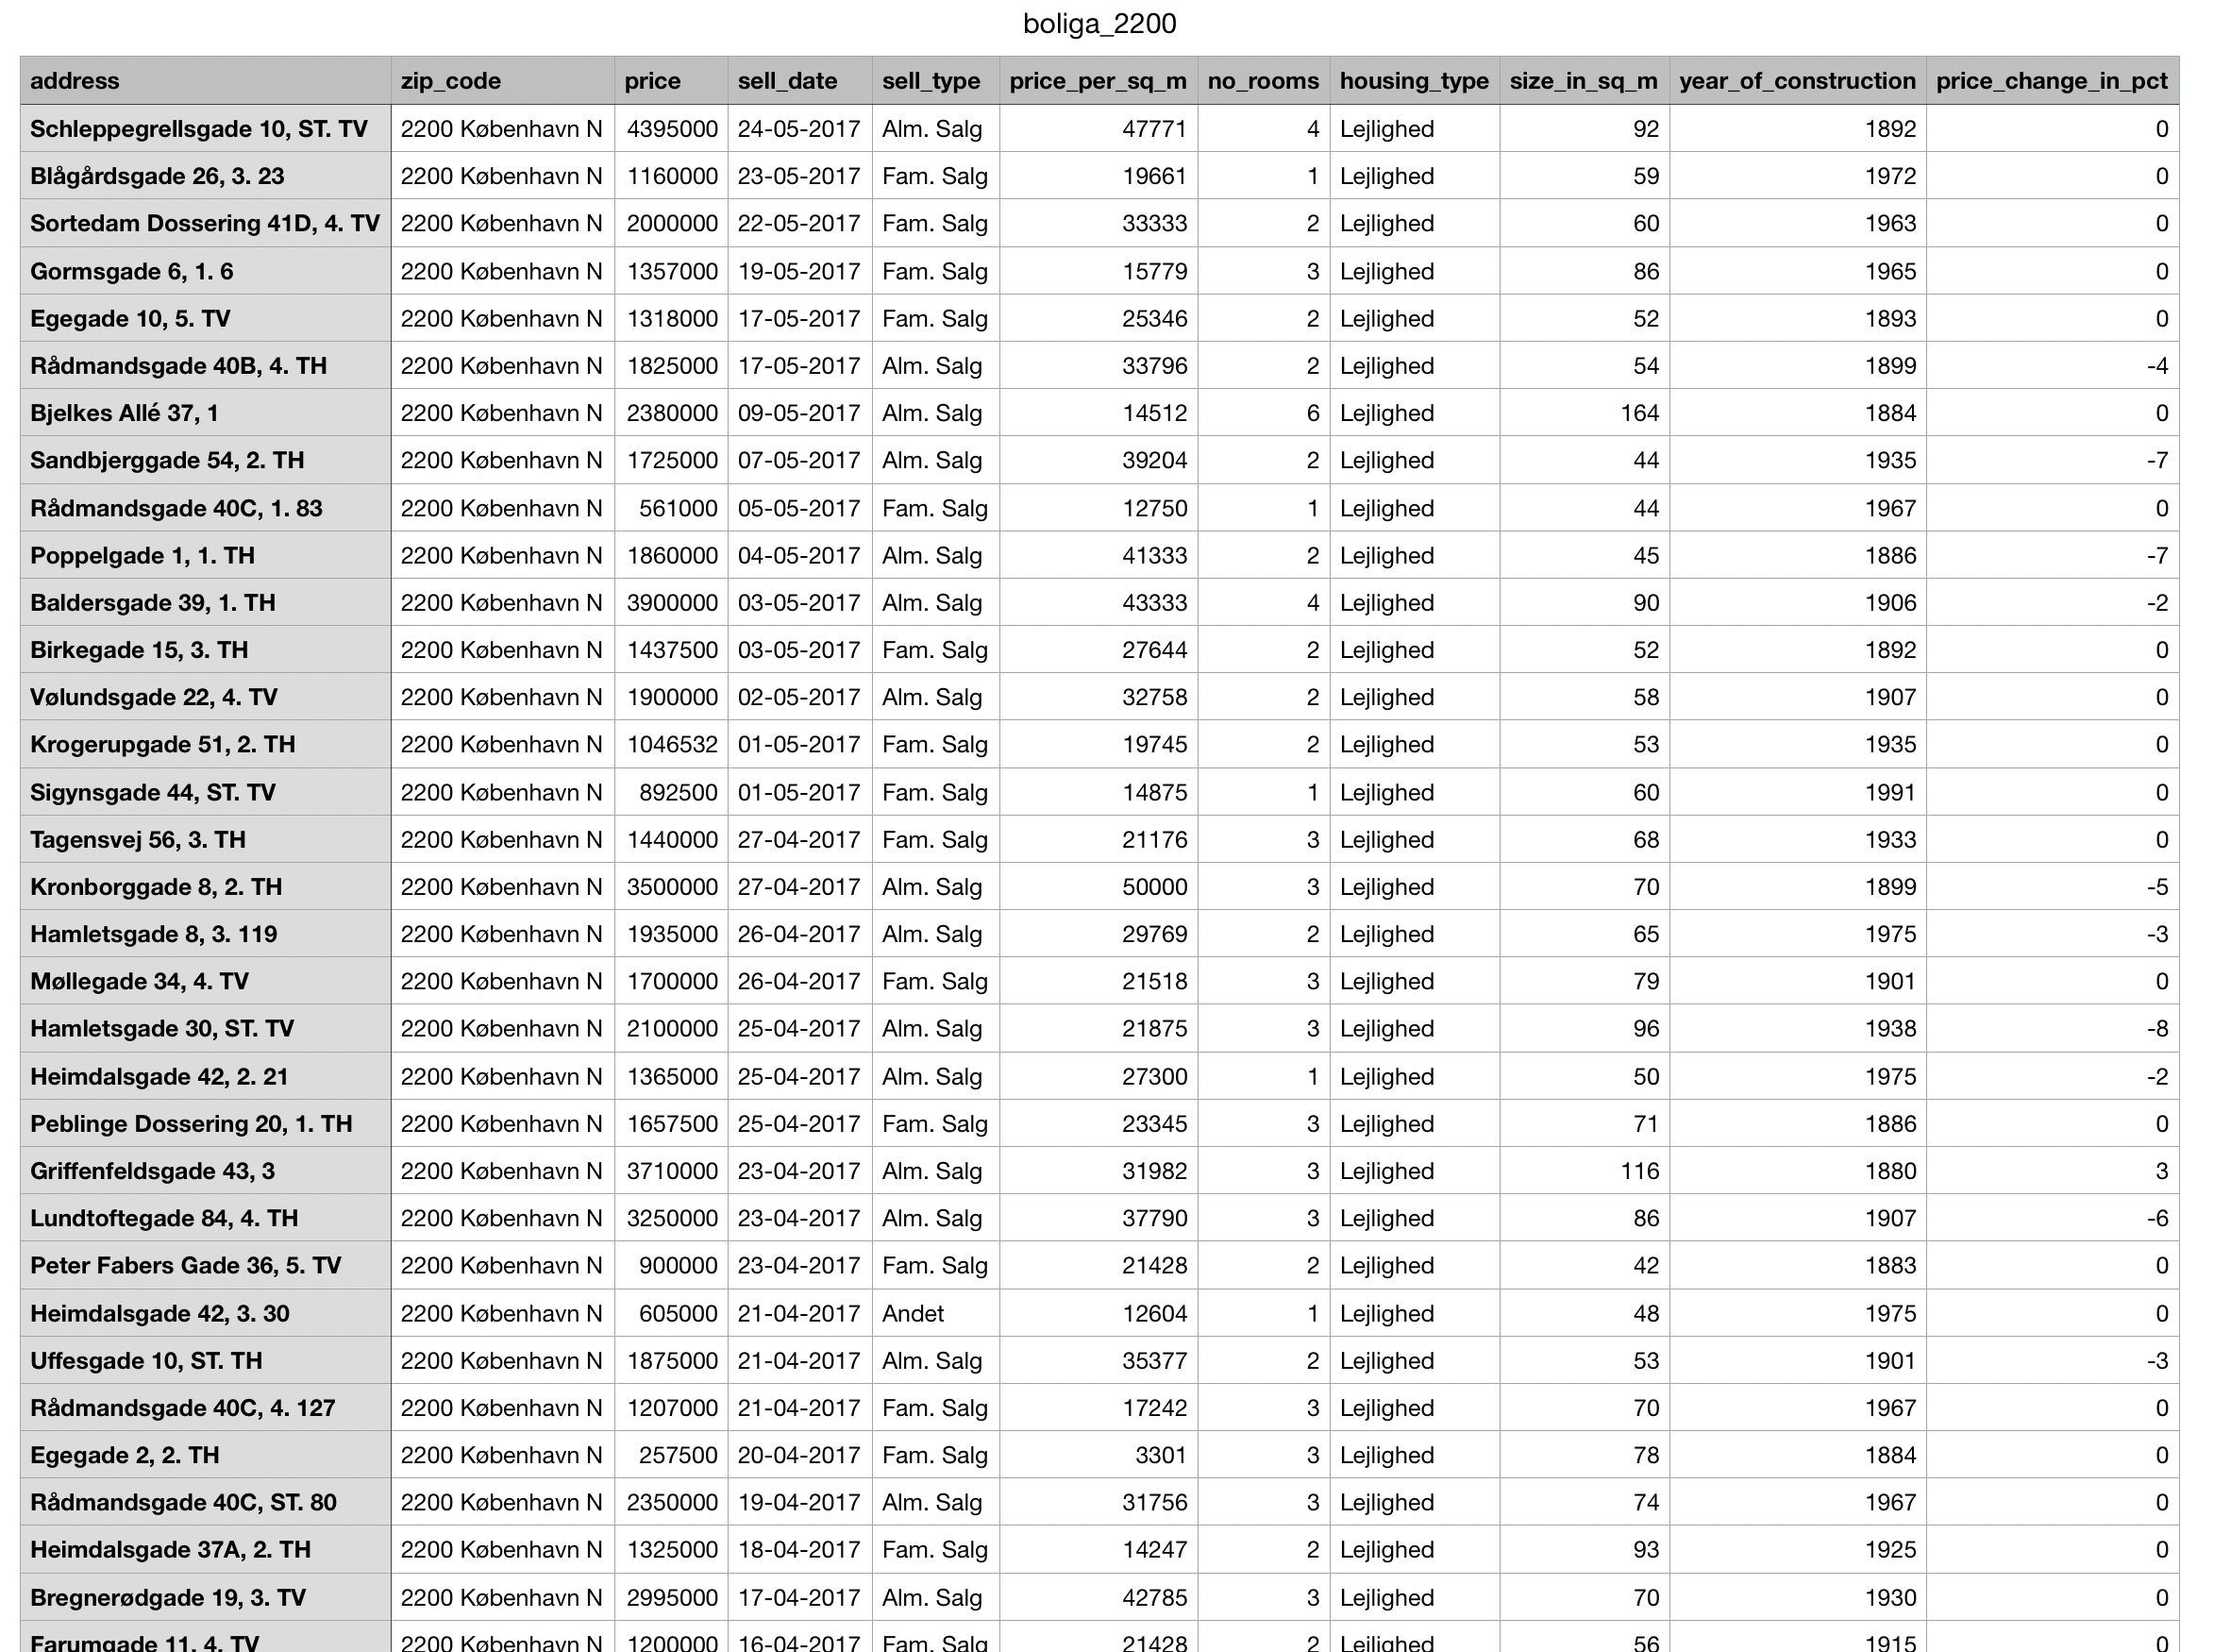
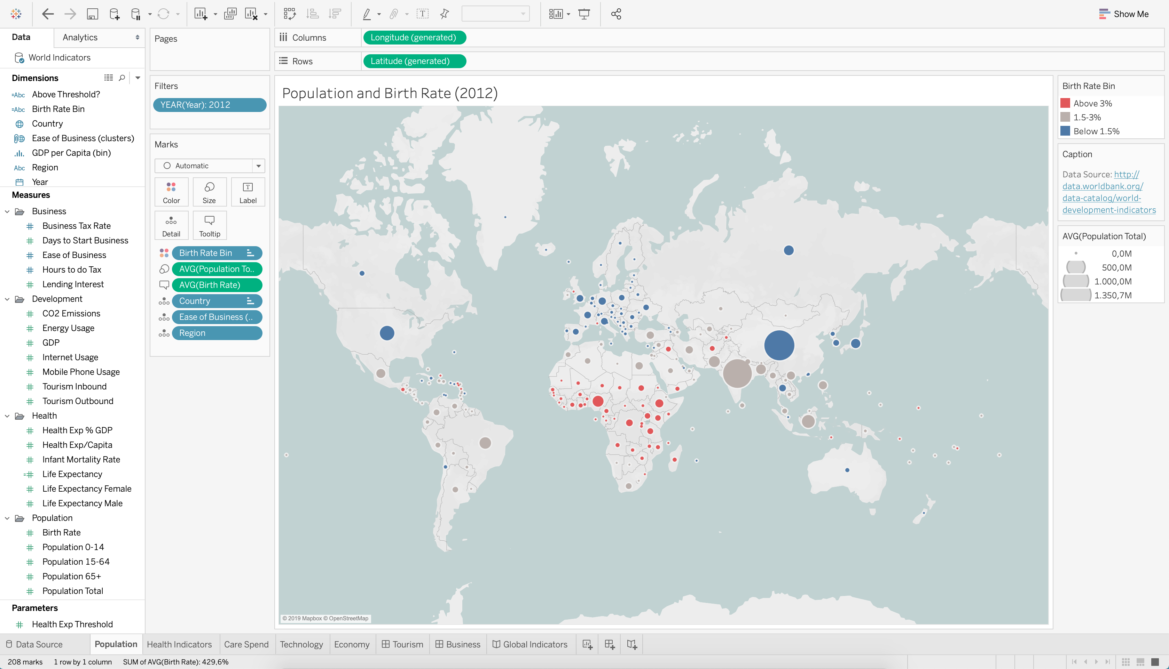
-- Extra Credits 2 --
Plot-It: Exercise in Tableu.
☺
*Get instructions from Jacob after class – if interested.

Slide 9
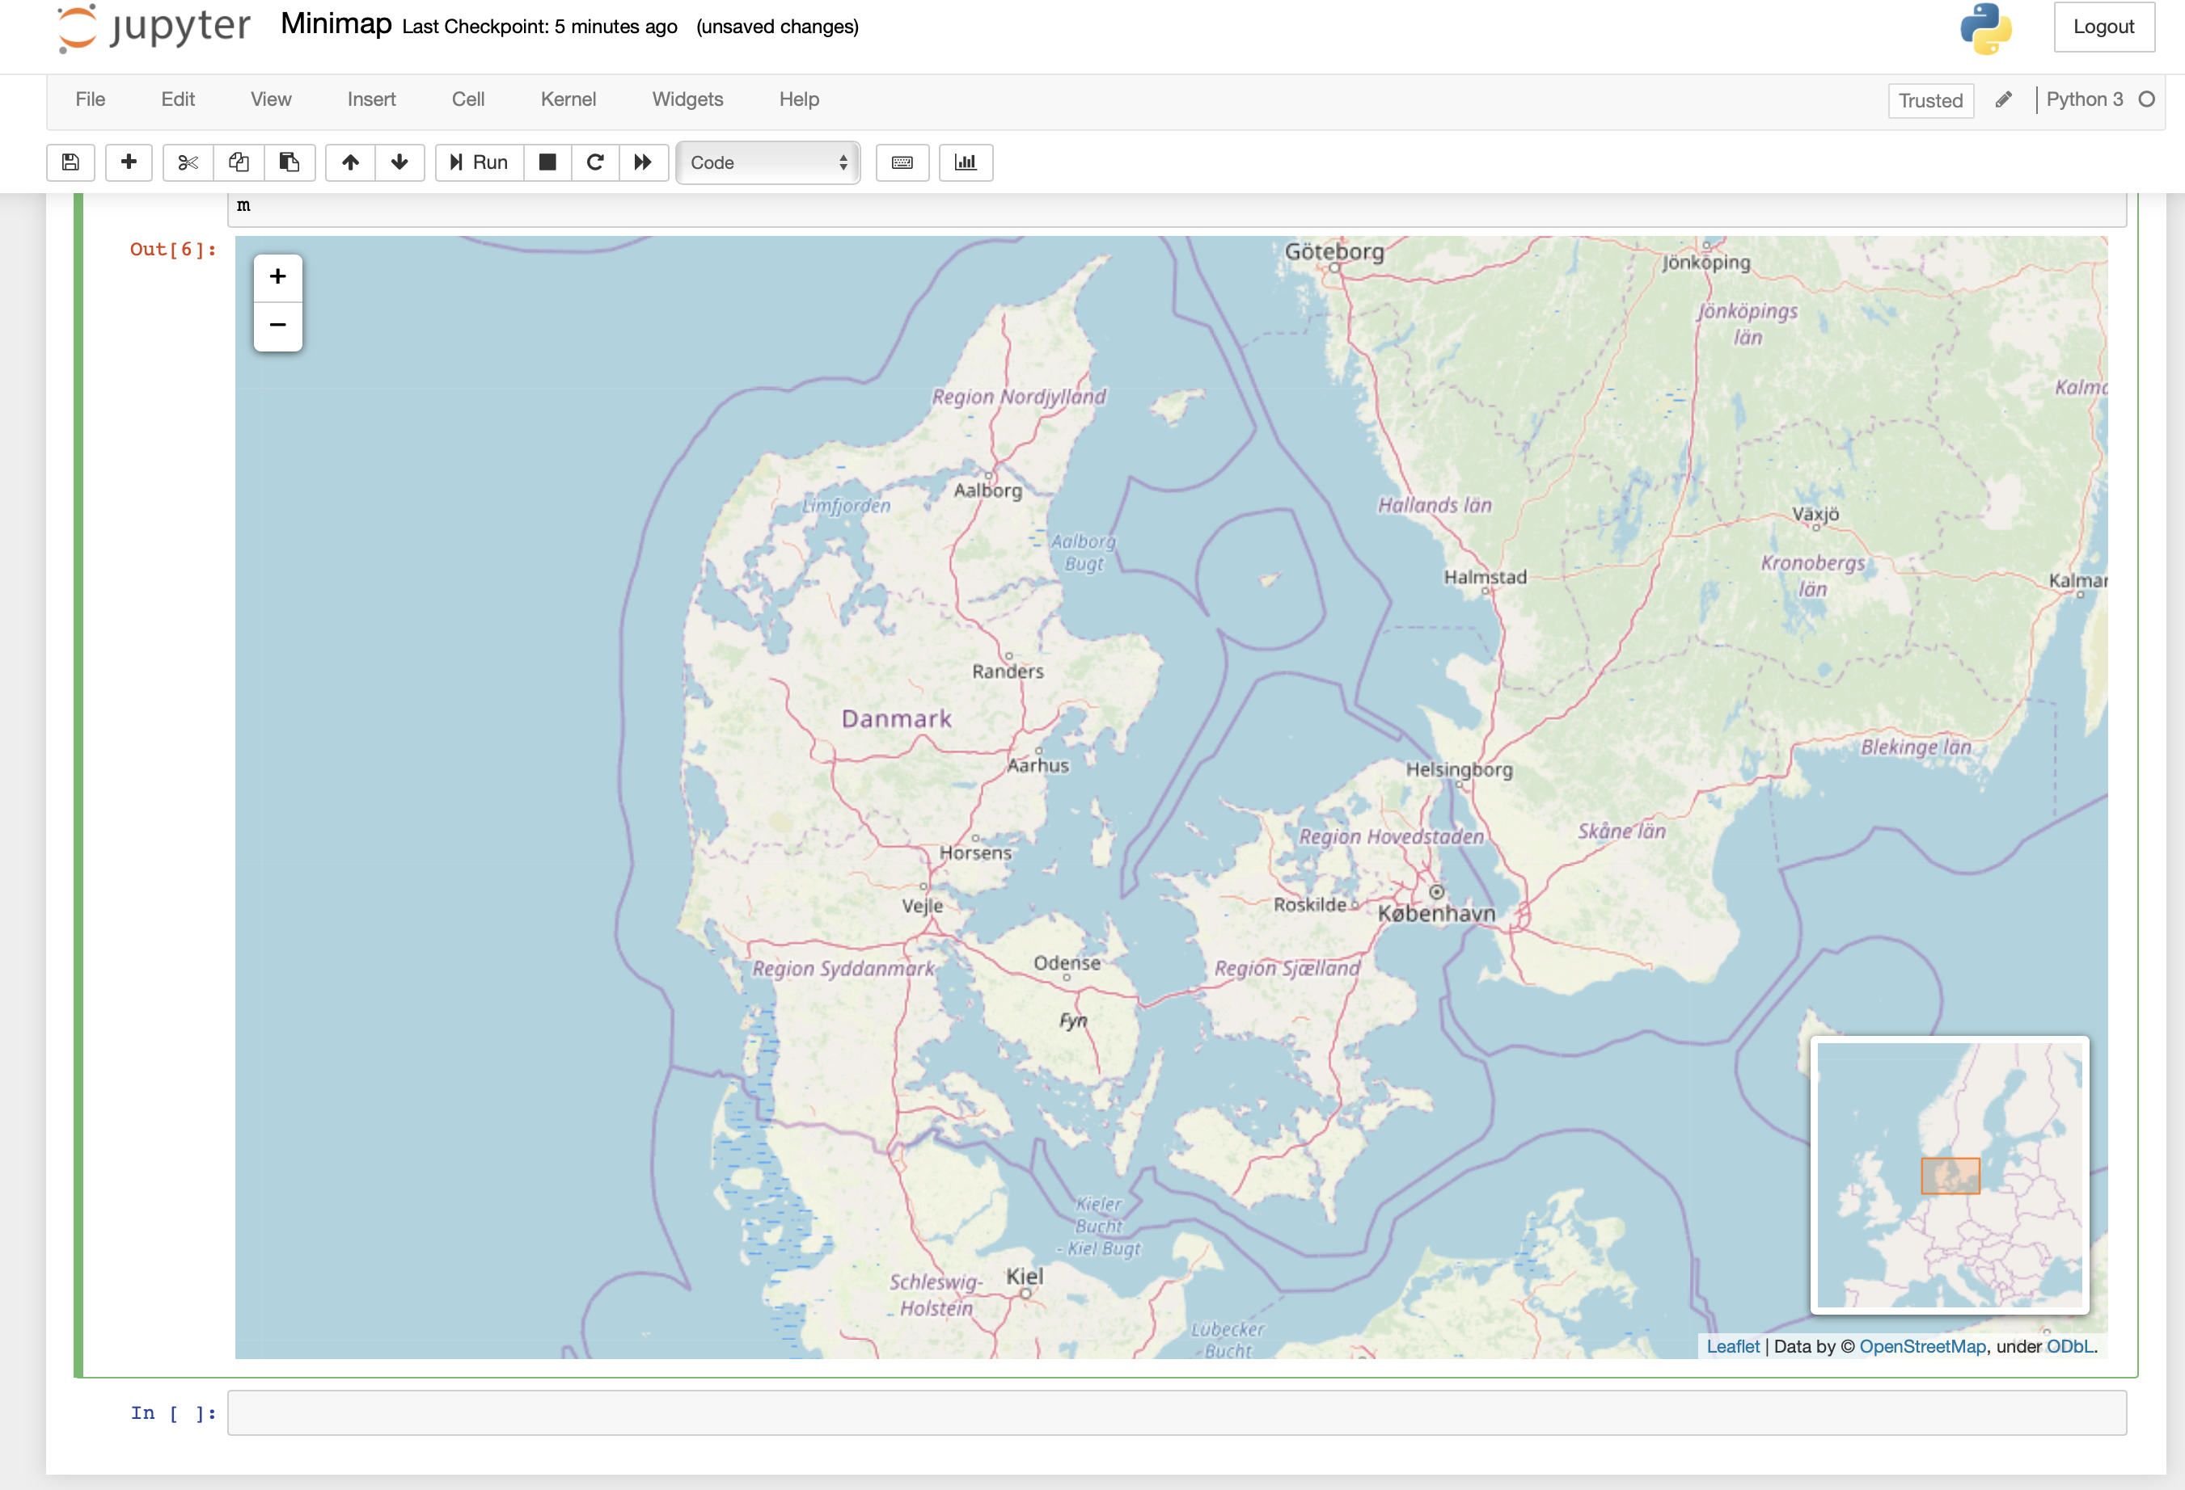
-- Extra Credits 3 --
Plot-It: Exercise in Folium (Python).
☺
*Get instructions from Jacob after class – if interested.

